Slide 1
VIEWS

Slide 2
Views
View is responsible for providing the UI to the user
View transforms the Model data to the format in which it needs to be presented to the user
The views are added to the Views Folder under a subfolder with a Controller name.
The view name is mapped to the Controller Action Name

Slide 3
Razor Views
The views are Razor Views
The Layout template + Razor View forms the output.

Slide 4
Strongly Typed Views
ViewData is a ViewDataDictionary
In the Controller method use the overload of View method to specify the model
This sets the ViewData.Model property to the Model
Then specify the @model in View Example
@model IEnumerable<MvcRestaurants.Models.RestaurantReview>

Slide 5
Default Views and Views in Other Locations
If no view is specified the Index View is considered
Views can be picked up from different directories by specifying the path with a ~

Slide 6
Razor Expressions
Implicit
@item.Rating
Explicit
@(item.Rating /10.0)

Slide 7
Razor Code Blocks
Razor is smart enough to distinguish between C# and Razor code.

Slide 8
Razor Comments and Escape
@* *@ is for Comments
@@ - To escape
@: - To output a string

Slide 9
Layout Views
Provides the skeleton
It is similar to master pages
Contains methods RenderBody() and RenderSection
RenderBody is responsible for rendering the action specific views

Slide 10
Layout View
<!DOCTYPE html>
<html>
<head>
<title>@ViewBag.Title</title>
<script src="@Url.Content("~/Scripts/jquery-1.4.4.min.js")" type="text/javascript"></script>
</head>
<body> @RenderBody() </body>
</html>

Slide 11
_ViewStart
This is where the layout view for the application is defined
This can be overridden by specifying a layout inside the folders. The one in the folders take precedence
Layout can also be null

Slide 12
Partial Views
Partial Views are reusable Views within the application
Partial Views can be called using @Html.Partial
They can also be called using @Html.Action which calls a sub-request to render a partial view
ChildActionOnly restricts calling it from HTML.Action

Slide 13
Alternate View Engines
Spark - Spark is a open source view engine for ASP.NET MVC projects as well as Castle MonoRail framework projects. This view engine is from the popular MVCContrib library.
NHaml - NHaml is another View Engine and works like an replacement of inline page templating .

Slide 14
Alternate View Engines
NDjango - NDjango is an implementation of Django Template Language using F#.
Hasic -Hasic is a ASP.NET View Engine that uses the VB.NET XML kind of literals.
Bellevue – Bellevue is another cool ASP.NET MVC View Engine that has the design goal which respects the HTML as first class

Slide 15
How to use Alternate View Engines
Ref:
http://stephenwalther.com/archive/2008/08/20/ asp-net-mvc-tip-35-use-the-nhaml-view-engine

Slide 16
Areas
Areas are an ASP.NET MVC feature used to organize related functionality into a group as a separate namespace (for routing) and folder structure
(for views). Using areas creates a hierarchy for the purpose of routing by adding another route parameter, area, to controller and action.

Slide 17
Areas
Your application is made of multiple high-level functional components that should be logically separated
You want to partition your MVC project so that each functional area can be worked on independently

Slide 18
Areas
An ASP.NET Core MVC app can have any number of areas
Each area has its own controllers, models, and views
Allows you to organize large MVC projects into multiple high-level components that can be worked on independently
Supports multiple controllers with the same name - as long as they have different areas

Slide 19
Areas
/Areas/<Area-Name>/Views/<Controller- Name>/<Action-Name>.cshtml
/Areas/<Area-Name>/Views/Shared/<Action- Name>.cshtml
/Views/Shared/<Action-Name>.cshtml

Slide 20
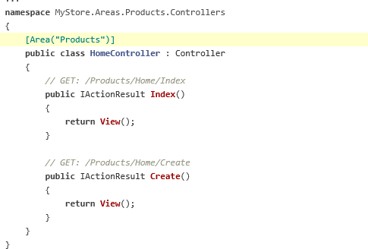
Areas

Slide 21
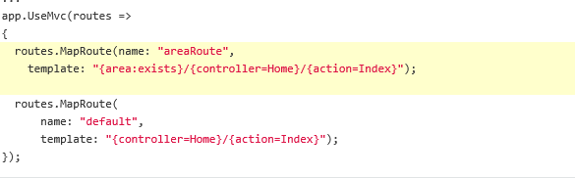
Areas

